Slide 1
Flight Computer for IlliniSat-2
Team 12
Mark Mahowald
Anuj Pasricha
Dan Brackmann
12/9/2014

Slide 2
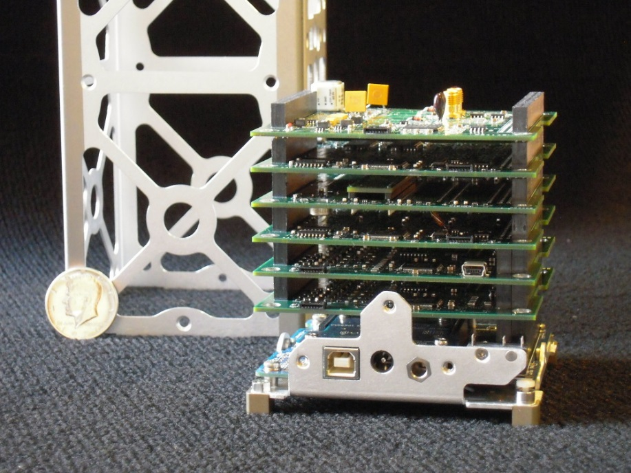
Introduction
What is a CubeSat?
The local CubeSat team
Vanderbilt CubeSat (http://www.isde.vanderbilt.edu/)

Slide 3
Objective
Designed and tested the Carrier and Data Handling (C&DH) board for the local CubeSat team
Enable the on-board processor to communicate with other satellite subsystems
Design a board in accordance with rigorous guidelines laid out by the CubeSat team

Slide 4
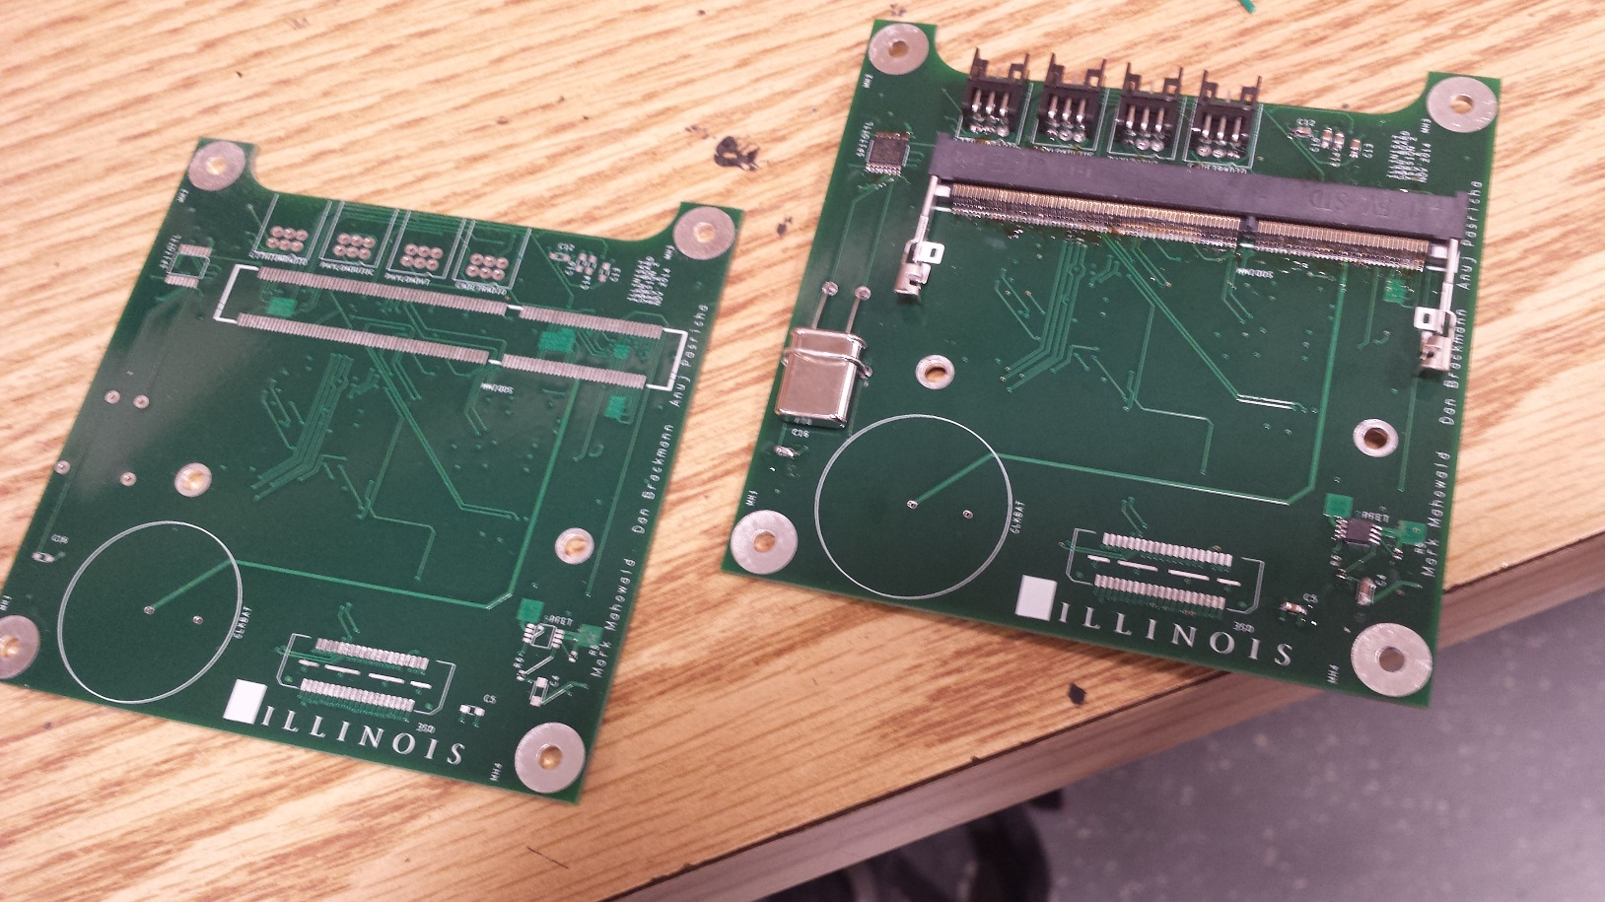
C&DH Board

Slide 5
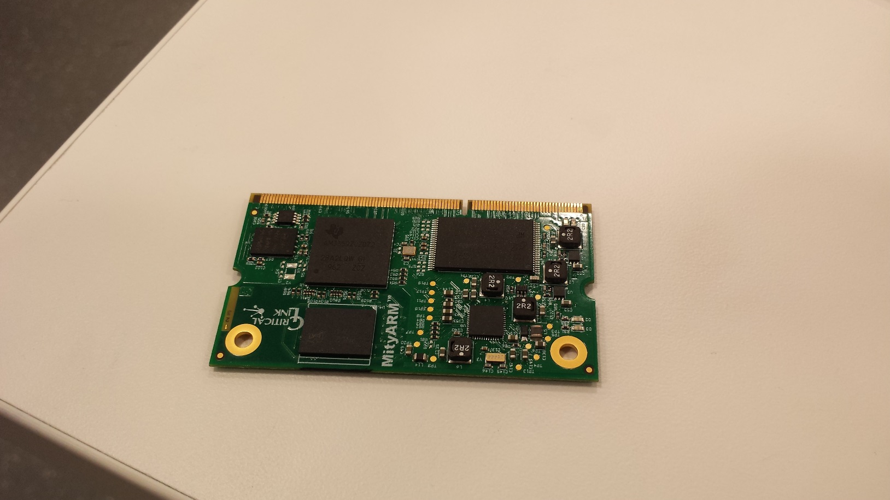
MitySOM Processor Module

Slide 6
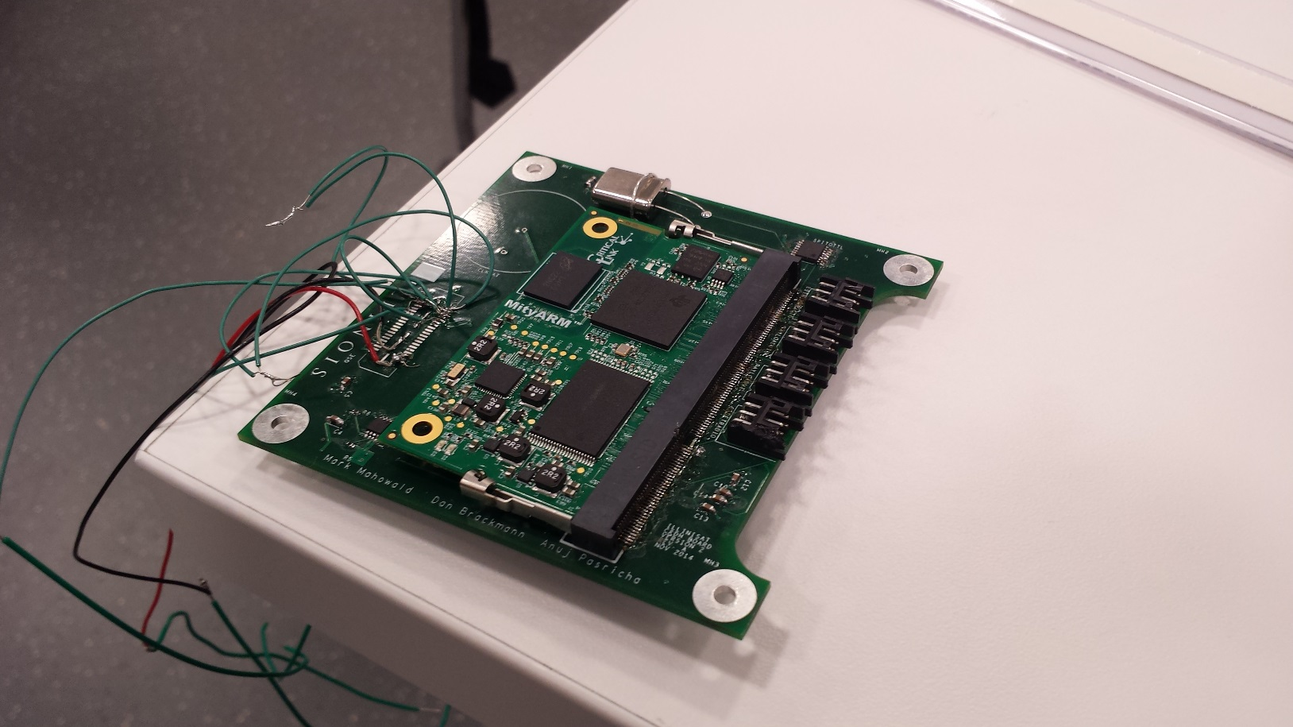
MitySOM Processor Module on C&DH Board

Slide 7
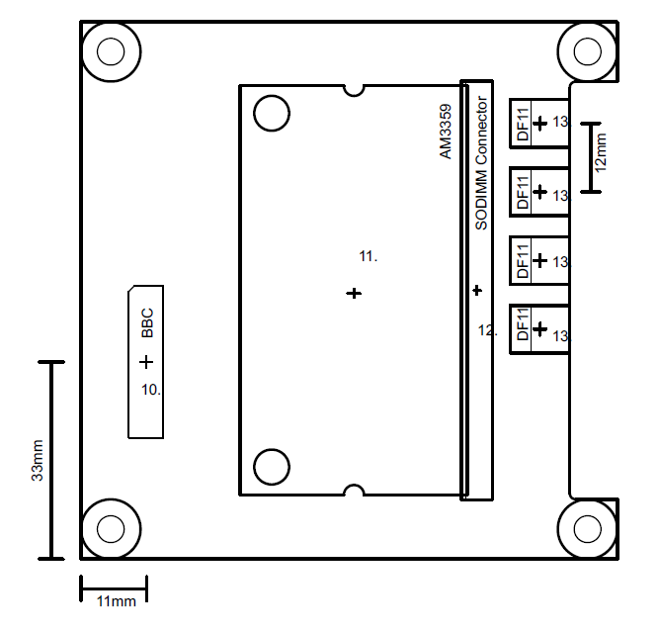
Mechanical Drawing

Slide 8
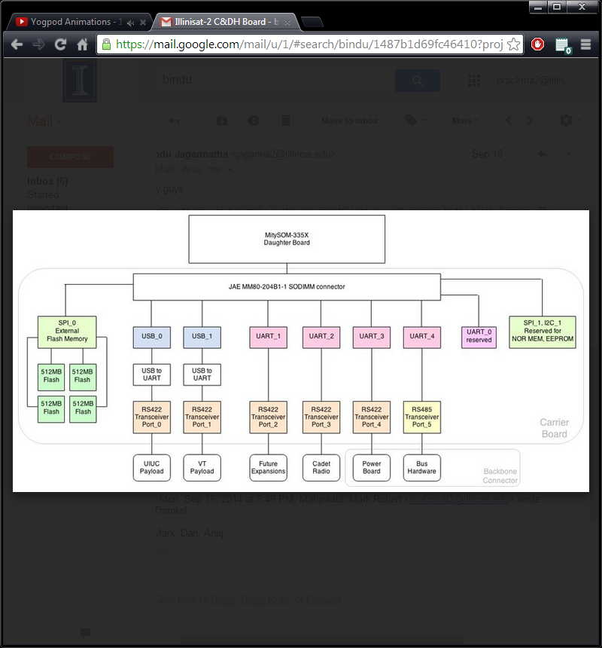
Original Design

Slide 9
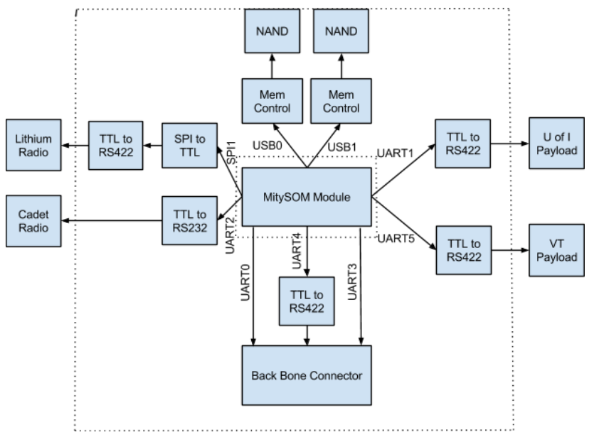
New Design
Master Block Diagram of CNDH board

Slide 10
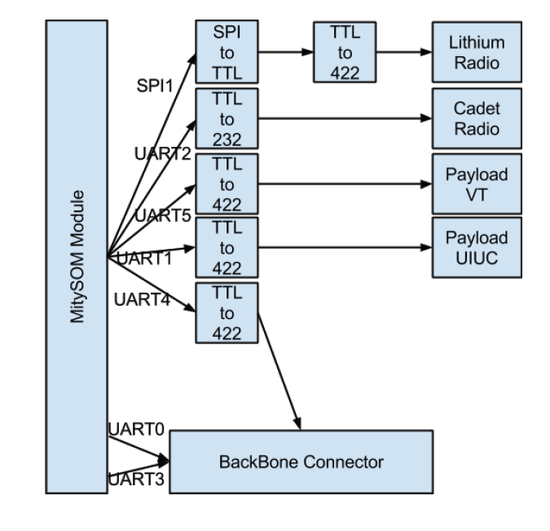
Communication
Communication Block Diagram

Slide 11
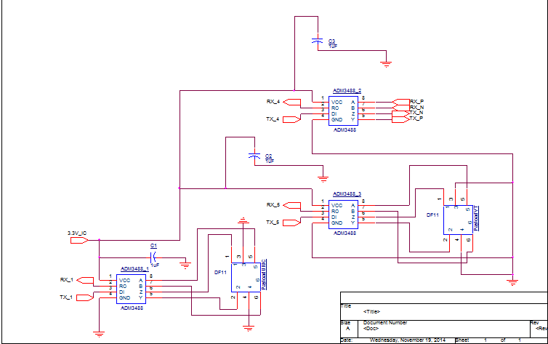
Communication : TTL to RS422

Slide 12
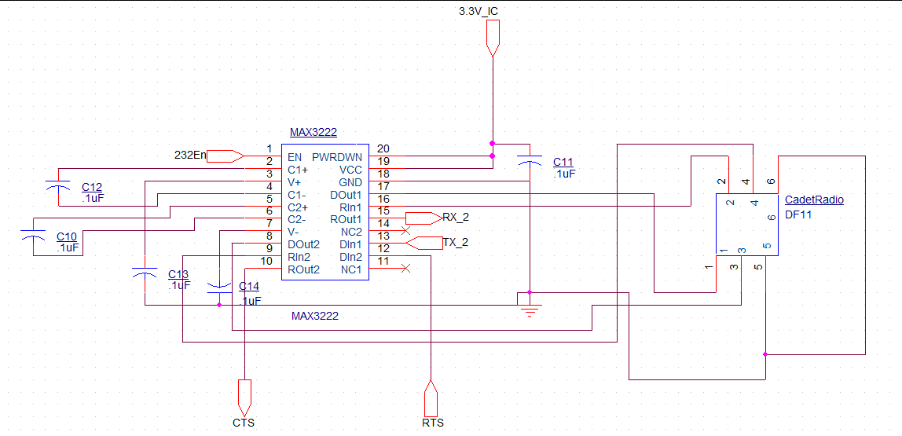
Communication : TTL to RS232

Slide 13
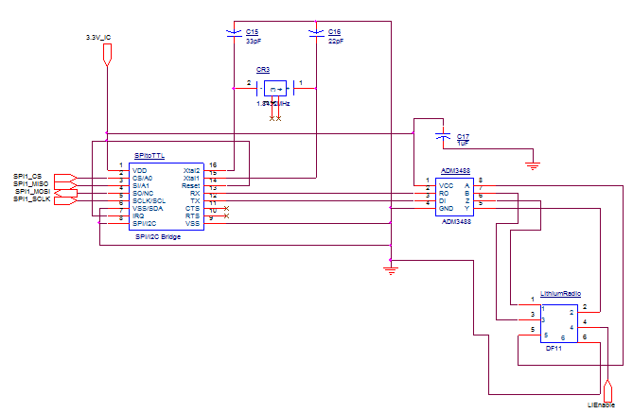
Communication : SPI to TTL

Slide 14
Transceiver R&V
TTL to RSXX2 Conversion works, both transmitting and receiving.
Verify using a simple test script that returns the same data sent through a loop back test.

Slide 15
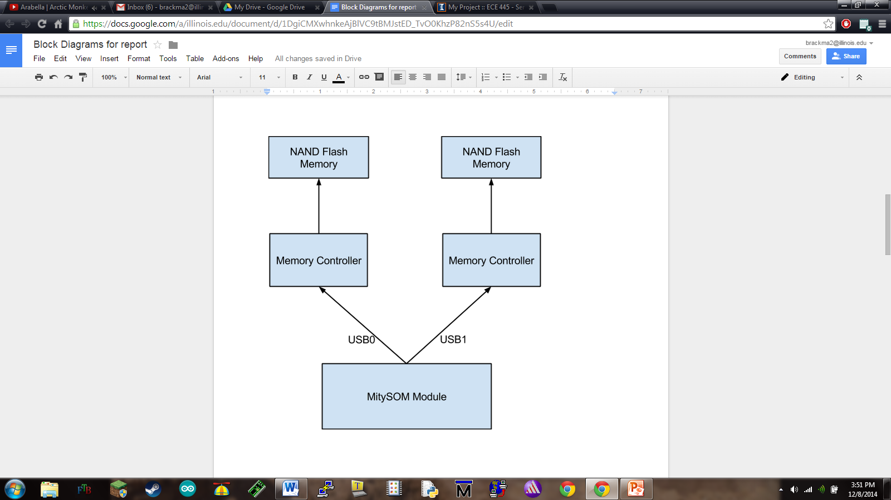
Memory
Memory Block Diagram

Slide 16
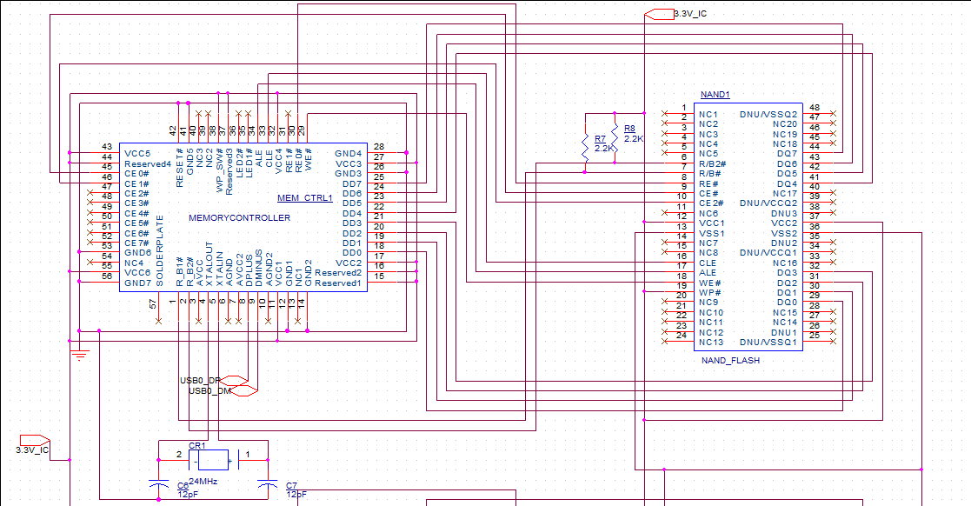
Memory Continued
Schematic of 1 cell of memory

Slide 17
Memory R&V
Reads and writes data from and to the MitySOM module.
Verify by writing a byte to the memory and reading it back.

Slide 18
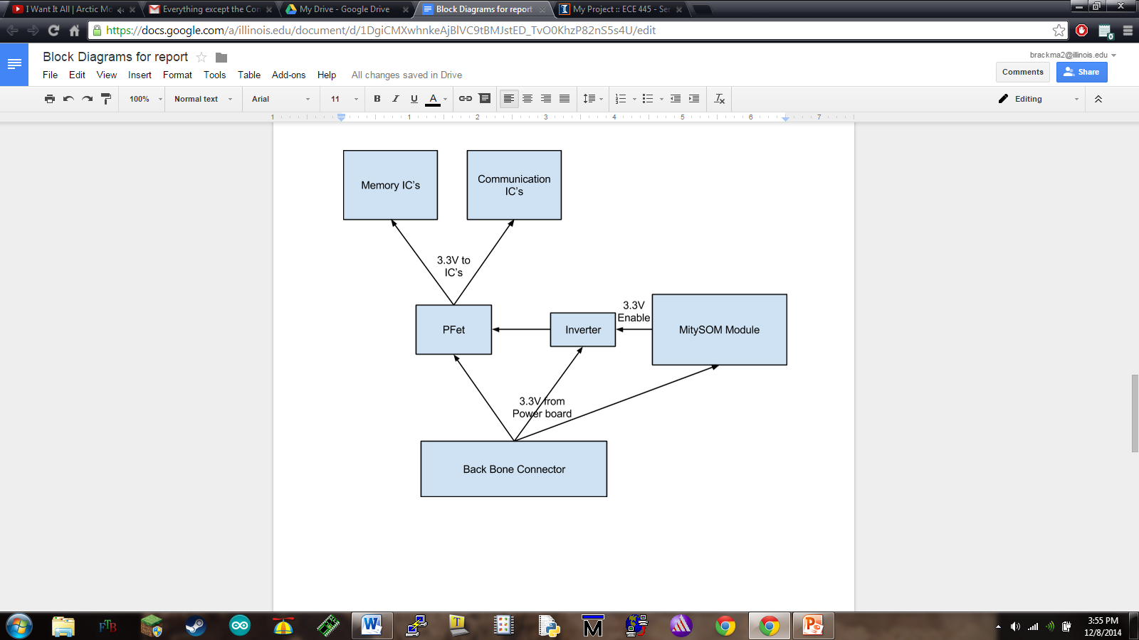
Power Sequencing
Power Sequencing Block Diagram

Slide 19
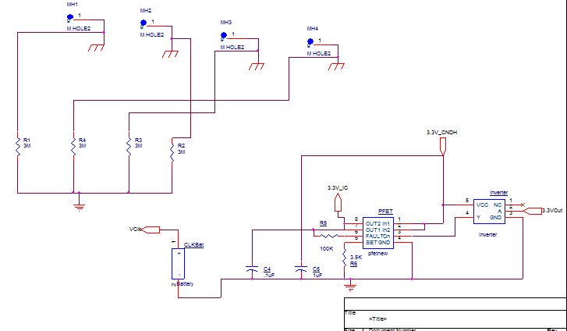
Power Sequencing Continued

Slide 20
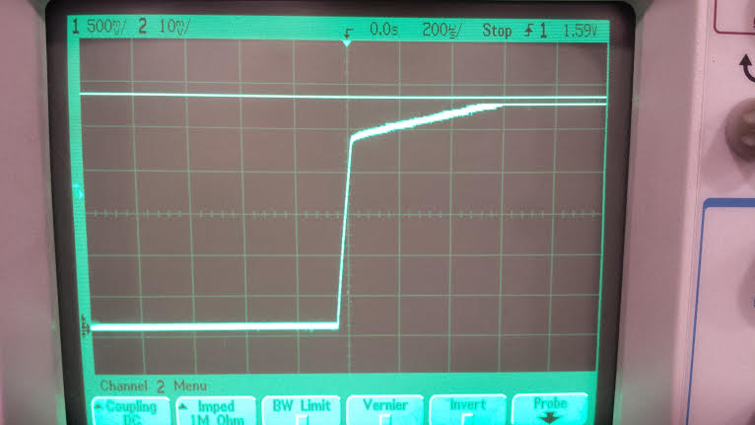
Test of Power Sequencing
Oscilloscope reading of the delay in the power sequencing

Slide 21
MitySOM Processor Module
MitySOM boots up from the C&DH board
Mount processor on C&DH board
Set up serial port using MiniCOM on Linux machine
Supply 3.3V to C&DH board
Success = Login terminal is displayed in MiniCOM window after bootup processes

Slide 22
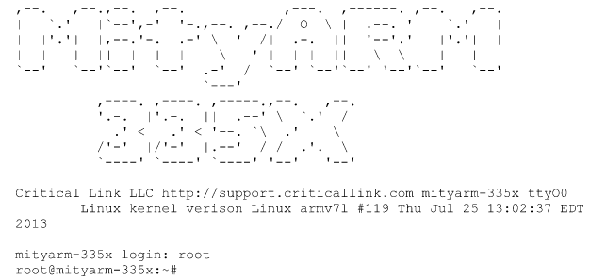
Boot Success

Slide 23
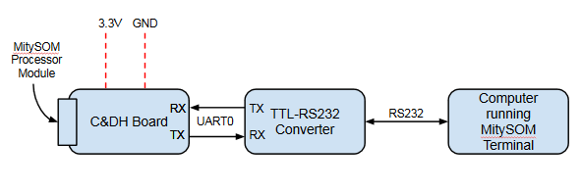
Boot Test Setup

Slide 24
UART Communication
Prerequisite: MitySOM bootup is successful
Payload (here, a Linux machine) can communicate to MitySOM processor module via UART3
Connect TX and RX connections for UART3 (loopback testing)
Run simulation script on MitySOM terminal
Success = Terminal displays text that the script sends

Slide 25
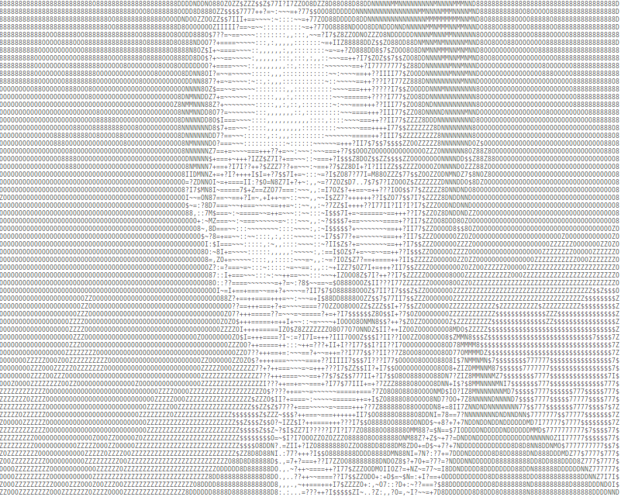
Transmitted Data

Slide 26
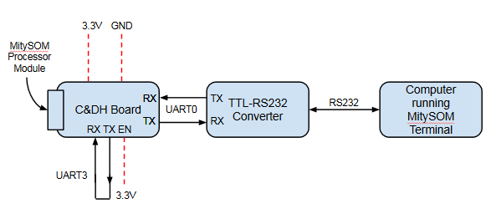
UART Test Setup

Slide 27
Vibrational Tests
C&DH Board must be able to handle extreme vibration due to launch
Components must stay connected during launch
Daughter card to SODIMM Connector
DF11 Connections
Soldered components

Slide 28
Effects of Vacuum
Outgassing
Gases inside the PCB bubble out, causing breaks in the routing
Solder whiskering
Phenomenon that happens to Tin based solder
Little whiskers grow out of the solder in space, causing shorts
Cooling
No air in space, so heat sinking is more difficult
Conduction is the only method for heat sinking in space

Slide 29
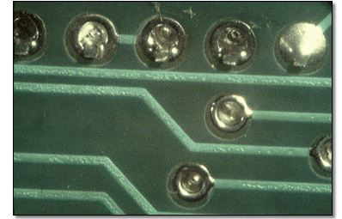
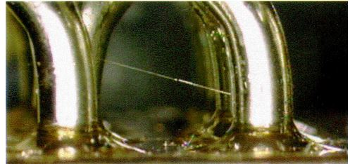
Outgassing and Solder Whiskering
Outgassing
Solder Whiskering

Slide 30
Testing Vacuum Effects
Outgassing and Solder whiskering
Set in a vacuum chamber overnight, check for shorts or broken components the next day
Efficient Heat Sinking
Set PCB in a vacuum chamber
Run operational tests described earlier
Verify the temperature stays within the operational limits of the board

Slide 31
Design Challenges
Late design freeze
Memory
Change in memory communication protocol
Communication
Change in transceivers

Slide 32
Successes
Power Sequencing
Boot-up and programming
Debugging
UART communication

Slide 33
Further Work
Minor fixes
TTL to UART Transceivers
Re-route one pin for SPI communication
Overloaded a MUX on the MitySOM, so pin out for current SPI won’t work
Memory Circuitry
Mechanical layout issues
Mechanical footprint for MitySOM daughter card was off

Slide 34
Conclusion
Close, but incomplete
Needs Memory Circuitry
Needs the Transceivers fixed (software issue)
Mechanical problems need to be resolved
Current board serves well for communication testing and boot up
Needs additional testing

Slide 35
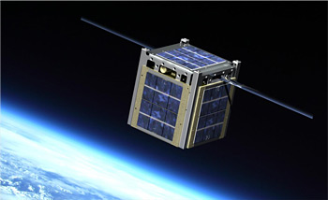
QUESTIONS???
Nasa.gov

